Slide 1
Chapter 9
Attraction and Close Relationships

Slide 2
The Need to Belong
The need to belong is a basic human motive.
We care deeply about what others think of us.
People who have a network of close social ties tend to be happier, healthier, and more satisfied with life than those who are more isolated.

Slide 3
The Thrill of Affiliation
Need for affiliation
  The desire to establish and maintain many rewarding interpersonal relationships
Individuals differ in the strength of their need for affiliation.
Stress arouses our need for affiliation
  “Misery loves the company of those in the same miserable situation” (Gump & Kulik 1997)

Slide 4
The Initial Attraction
We are attracted to others with whom a relationship is directly or indirectly rewarding.
All humans exhibit patterns of attraction and mate selection that favor the conception, birth, and survival of their offspring.
  Evolutionary perspective
The way that people meet has transformed in an explosive way over the past 20 years

Slide 5
How Couples Tend to Meet: Past and Present
Notes:
Figure 9.3 How Couples Tend to Meet: Past and Present
Source: Rosenfeld et al., 2019.

Slide 6
Familiarity: Being There
To whom are we most likely to become attracted?
Two factors in the attraction process:
  The proximity effect
  The mere exposure effect

Slide 7
The Proximity Effect
The single best predictor of whether two people will get together is—or used to be—physical proximity or nearness.
Where we live influences the friends we make
  College students tend to date those who live either nearby or in the same type of housing as them.

Slide 8
The Mere Exposure Effect
The phenomenon whereby the more often people are exposed to a stimulus, the more positively they evaluate that stimulus.
Contrary to folk wisdom, familiarity does not “breed contempt”

Slide 9
Physical Attractiveness
We react more favorably to others who are physically attractive than to those who are not.
A human bias for beauty is pervasive.
Is physical beauty an objective or subjective quality?

Slide 10
What Is Beauty?
Some researchers do believe that certain faces are inherently more attractive on average than others.
  High level of agreement among children and adults, men and women, and people from the same or different cultures
  Physical features of the human face are reliably associated with ratings of attractiveness
  Babies prefer faces considered attractive by adults

Slide 11
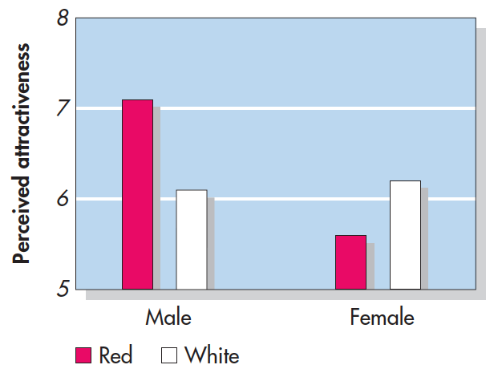
Elliot & Nesta (2008)
Notes:
Figure 9.6 Romantic Red: The Color of Attraction? In this experiment, college students rated pictures of women that were set against a solid red or white background. Perhaps illustrating a learned association between the color red and romance, male students—but not their female counterparts—rated the pictured women as more attractive in the red background condition.
From Elliot & Niesta (2008).

Slide 12
Why Are We Blinded by Beauty?
What-is-beautiful-is-good stereotype
  The belief that physically attractive individuals also possess desirable personality characteristics
  Good-looking people do have more friends, better social skills, and are more successful at attracting a mate.

Slide 13
Major et al. (1984)
How does one’s perceived attractiveness effect perceptions of praise?
Participants wrote an essay received praise from a same-sex or opposite sex evaluator
  Half saw the participant, half were unseen
Is there a relationship between how a person view’s themselves and whether they internalize praise?
Notes:
Figure 9.7 When Being Seen Leads to Disbelief People who believed they were physically unattractive were more likely to cite the quality of their work as the reason for receiving a positive evaluation when they thought they were seen by the evaluator. However, people who believed they were attractive were less likely to credit the quality of their work when they thought they were seen. From Major et al. (1984).

Slide 14
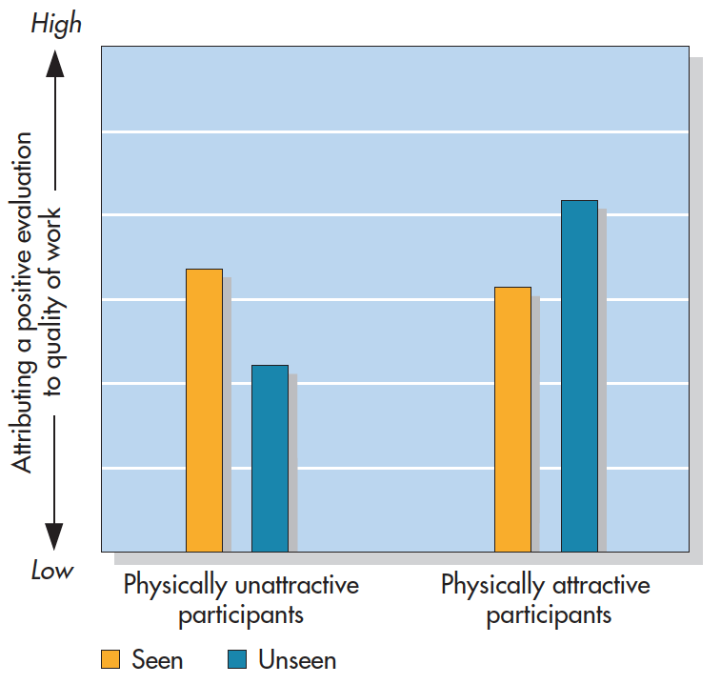
Major et al. (1984)
Notes:
Figure 9.7 When Being Seen Leads to Disbelief People who believed they were physically unattractive were more likely to cite the quality of their work as the reason for receiving a positive evaluation when they thought they were seen by the evaluator. However, people who believed they were attractive were less likely to credit the quality of their work when they thought they were seen. From Major et al. (1984).

Slide 15
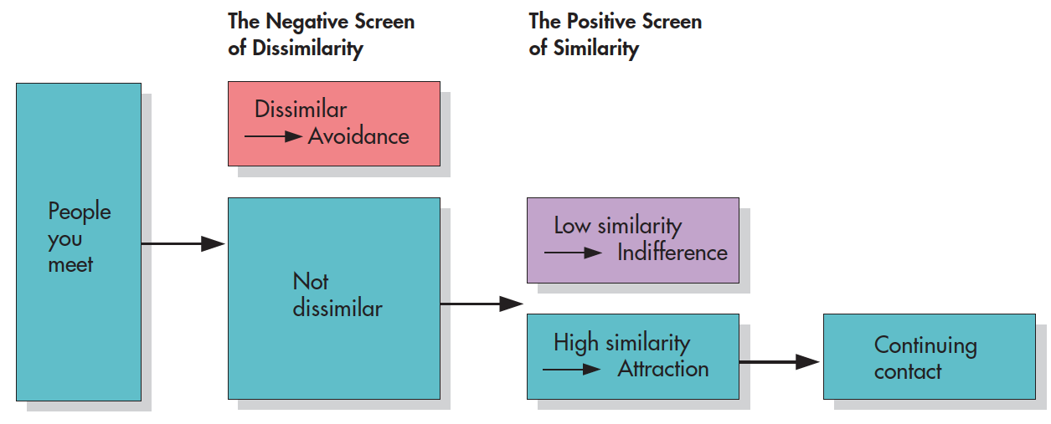
How does attraction work?
Two stage model of attraction (Byrne et al., 1986)
We first avoid people who are dissimilar then approach people who are highly like us
Notes:
Figure 9.9 A Two-Stage Model of the Attraction Process This two-stage model of attraction holds that we first avoid dissimilar others and then approach similar others.
Source: Byrne et al., 1986.

Slide 16
What is “similarity”?
Four types of similarity are most relevant:
  Demographic, attitude, attractiveness, and subjective experience
People tend to become involved romantically with others who are “equivalent” in their physical attractiveness.

Slide 17
Need for affiliation
Fear of being single?
Spielmann et al. (2013)
  Participants completed the Fear of Being Single Scale
  Next participants rated romantic interest in fake dating profiles (half attractive, half unattractive)

Slide 18
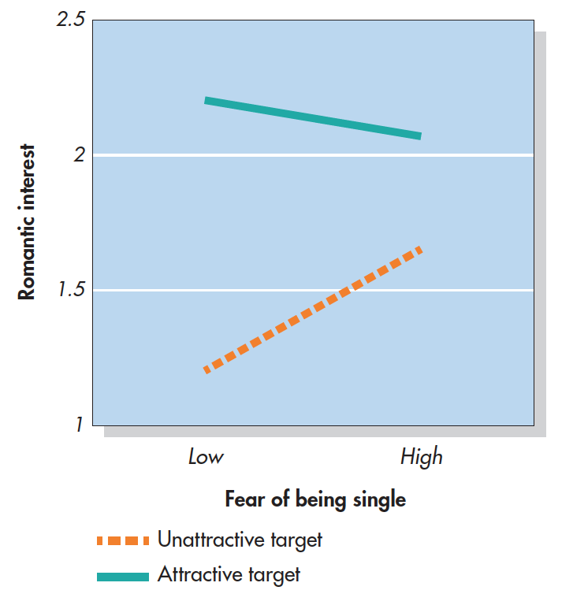
Spielmann et al (2013)
Notes:
Figure 9.10 Settling for Less For Fear of Being Single? In this study, 214 single and straight men and women completed the Fear of Being Single Scale and then rated their romantic interest in bogus profiles from an online dating site. The profiles depicted someone who was more or less attractive and more or less responsive. As you can see, everyone preferred the more desirable profiles. But participants who feared being single also showed an interest in profiles that were not attractive or responsive
(Spielmann et al., 2013).

Slide 19
Pursuing Those Who Are Hard to Get
Hard-to-get effect
  The tendency to prefer people who are highly selective in their social choices over those who are more readily available
We are turned off by those who reject us because they are committed to someone else or have no interest in us.

Slide 20
Mate Selection
Proximity and similarity play large roles in mate selection
But are there gender differences?

Slide 21
Evolutionary Perspective
Human beings all over the world exhibit mate-selection patterns that favor the conception, birth, and survival of their offspring.
  Women are biologically limited in the number of children they can bear and raise in a lifetime.
    Must be selective! Would predict that women are attracted to men with greater resources
  Men can father an unlimited number of children
    Less need for selectivity

Slide 22
Evolutionary Perspective
Finkel & Eastwick (2008)
  Had heterosexual men and women complete a speed dating task
  Prior to the task, rated their preferences for a potential partner (attractiveness, wealth, etc.)
  During the speed dating task they rated their dates
  Do preferences match up with actual outcomes?

Slide 23
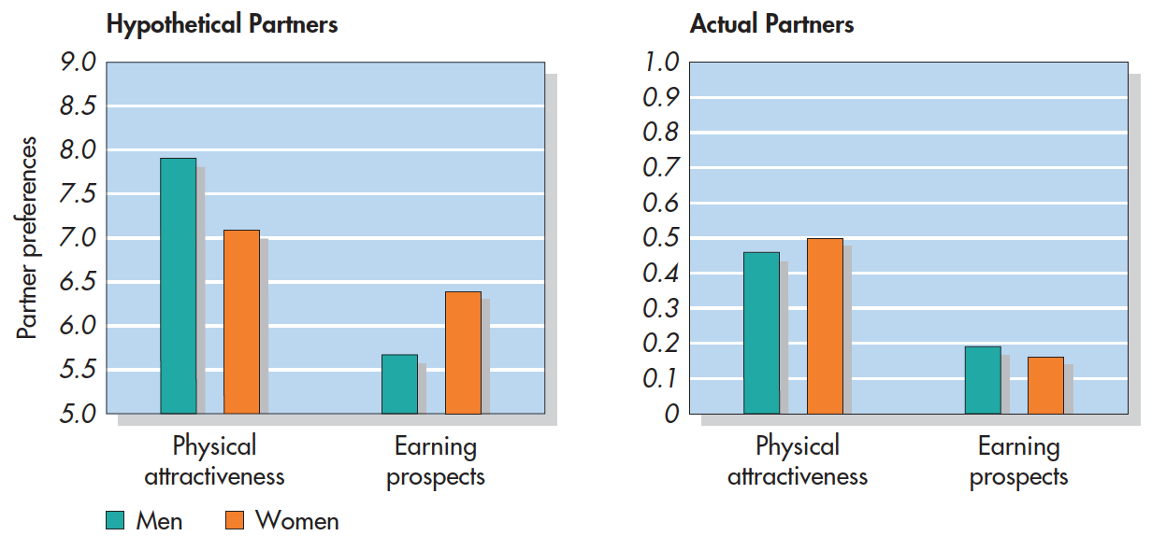
Finkel & Eastwick (2008)
Notes:
Figure 9.12 Evolutionary Mate Preferences: In Theory and in Practice Before they engaged in speed dating, male and female participants stated their preferences for an ideal partner. Consistent with the evolutionary perspective, males were more likely to cite “physically attractive,” and females were more likely to cite “earning prospects” (left). In ratings of actual speed dating partners, however, male and female participants did not differ in their preferences for these characteristics (right). From Finkel & Eastwick (2008).

Slide 24
Jealousy
Jealousy is a common and normal human reaction.
Men and women may be aroused by different triggering events.
  Evolutionary perspective: Men are more fearful of a mate’s sexual infidelity (which threatens paternal certainty) and women worry more about emotional infidelity (which threatens future support).

Slide 25
Intimate Relationships
A close relationship between two adults involving emotional attachment, fulfillment of psychological needs, or interdependence.
How do we advance from our first encounters to intimate relationships?
  By stages or by leaps and bounds?
What are the qualitative differences in close relationships, e.g., friendship versus romantic love?

Slide 26
The Intimate Marketplace: Tracking the Gains and Losses
Social exchange theory
  A perspective that views people as motivated to maximize benefits and minimize costs in their relationships with others.
The development of an intimate relationship is clearly associated with the overall level of rewards and costs.

Slide 27
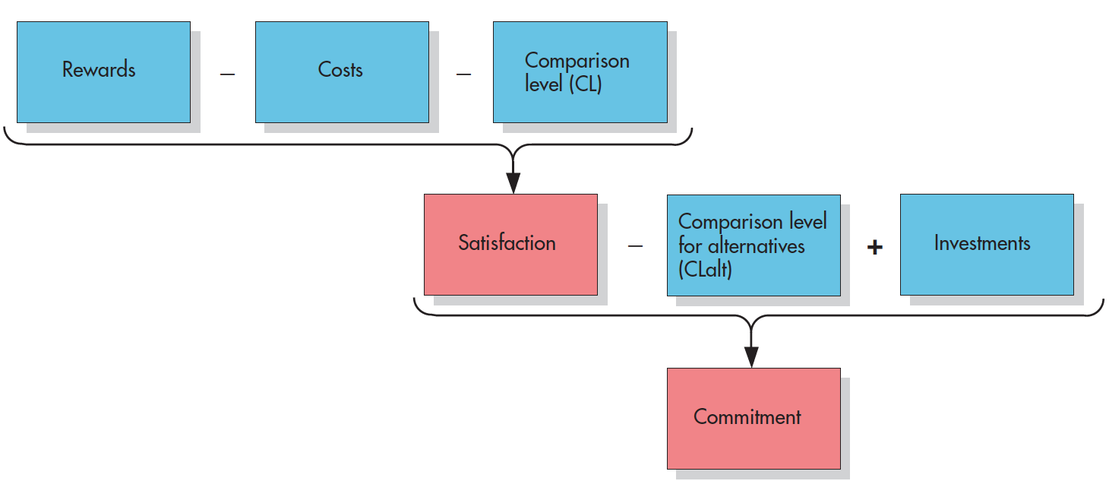
Relational Building Blocks
Notes:
Figure 9.13 Relational Building Blocks The building blocks of social exchange are rewards, costs, comparison level for alternatives, and investments. These factors are strongly associated with the satisfaction and commitment partners experience in their relationship.

Slide 28
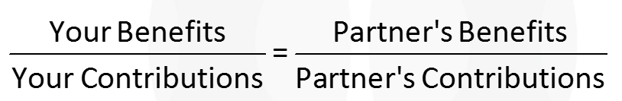
Equity Theory
The theory that people are most satisfied with a relationship when the ratio between benefits and contributions is similar for both partners.
The balance is what counts.

Slide 29
Types of Relationships
Exchange relationships: A relationship in which the participants expect and desire strict reciprocity in their interactions.
Communal relationships: A relationship in which the participants expect and desire mutual responsiveness to each other’s needs.

Slide 30
Sternberg’s Triangular Theory of Love
Sternberg’s triangular theory of love
  A theory proposing that love has three basic components—intimacy, passion, and commitment—that can be combined to produce eight subtypes.

Slide 31
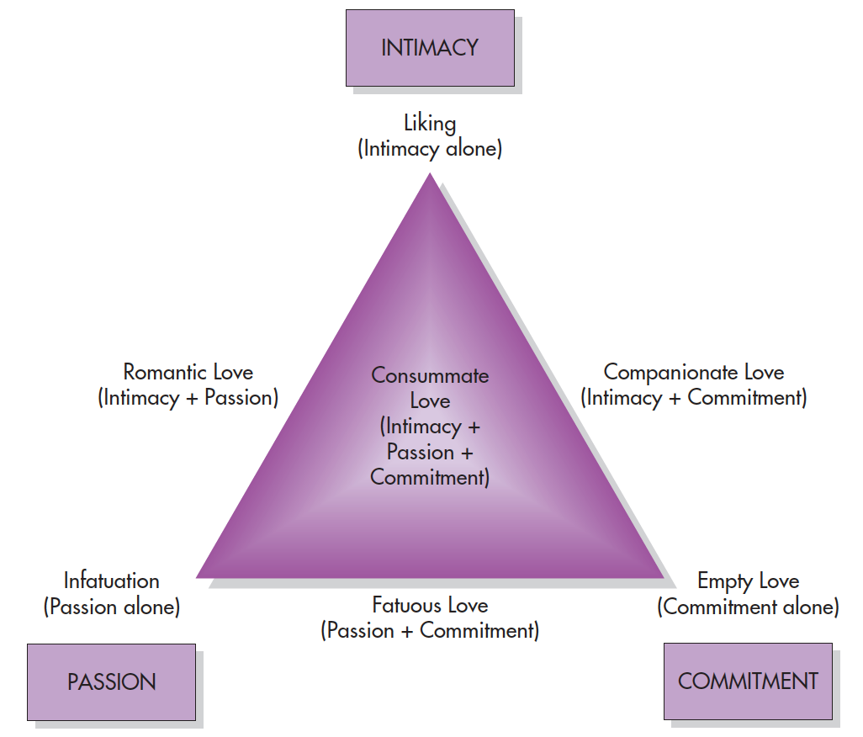
Sternberg’s Triangular Theory of Love
Notes:
Figure 9.14 Sternberg’s Triangular Theory of Love According to Sternberg, various combinations of passion, intimacy, and commitment give rise to seven different types of love. (Although it is not shown, the absence of all three components produces an eighth result, nonlove.) From Sternberg & Barnes (1986).

Slide 32
Passionate Love
Romantic love characterized by high arousal, intense attraction, and fear of rejection
Excitation transfer
  The process whereby arousal caused by one stimulus is added to arousal from a second stimulus and the combined arousal is attributed to the second stimulus.

Slide 33
Companionate Love
A slow-building, secure, trusting, and stable partnership
Compared to the passionate form of love, companionate love is less intense but is in some respects deeper and more enduring.
Self-disclosure
  Revelations about the self that a person makes to others
  Higher emotional involvement increases self-disclosure

Slide 34
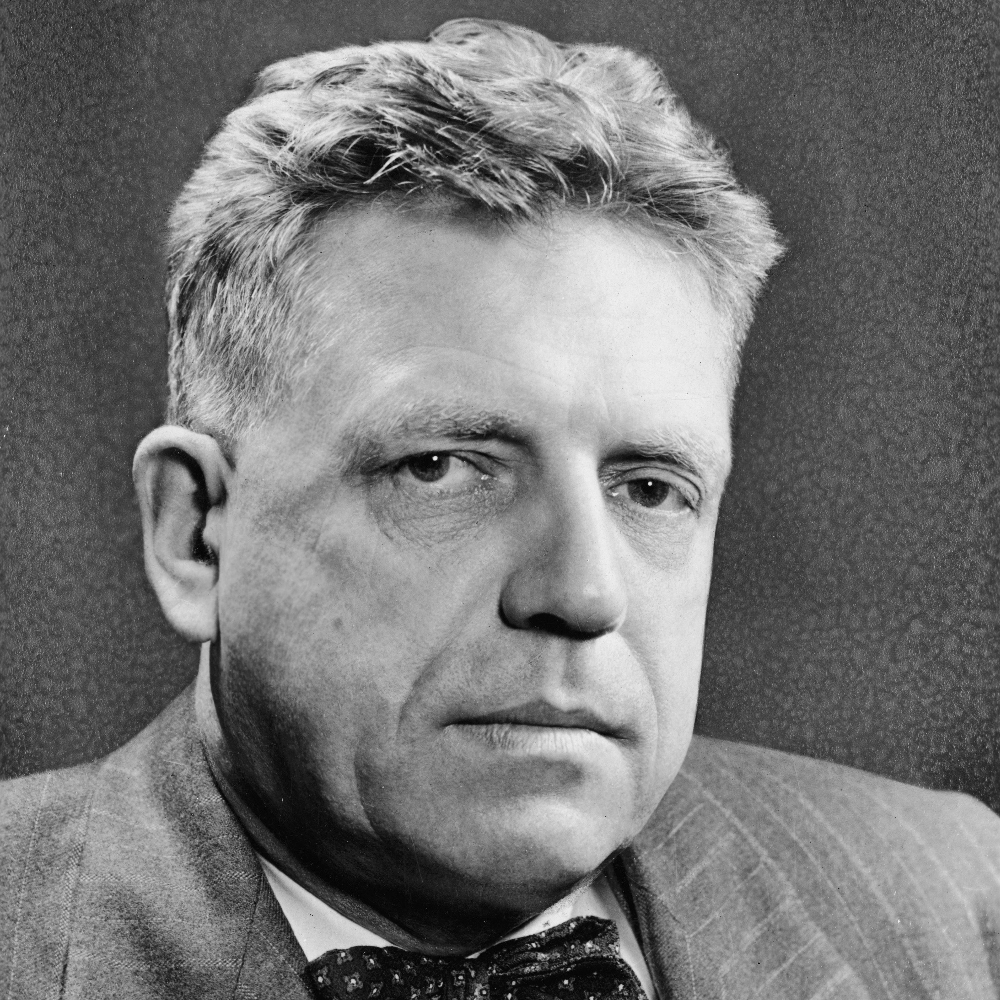
Alfred Kinsey
Kinsey’s groundbreaking research on sex during the 1940s
  Problems with studying sexual activities?
Kinsey scale:
  Sexual orientation reflects a continuum rather than a binary dimension

Slide 35
Kinsey’s Research: Findings
69% of White males in US had sexual relations with prostitutes
~4% of American males were homosexual
~6% of American females were homosexual
Sexual relations tended to decrease over time for married couples

Slide 36
Kinsey’s Research: Criticisms
Sample disproportionately included prisoners, many of whom were sex offenders
Also disproportionately included college students

Slide 37
Sexual Orientation
Large scale surveys suggest that:
  About 3%-4% of men are exclusively homosexual
  About 2% of women are exclusively homosexual
Varies with generations and among cultures.

Slide 38
Relationship Satisfaction
73% of American college students surveyed said they would sacrifice most other life goals rather than give up a satisfying relationship.

Slide 39
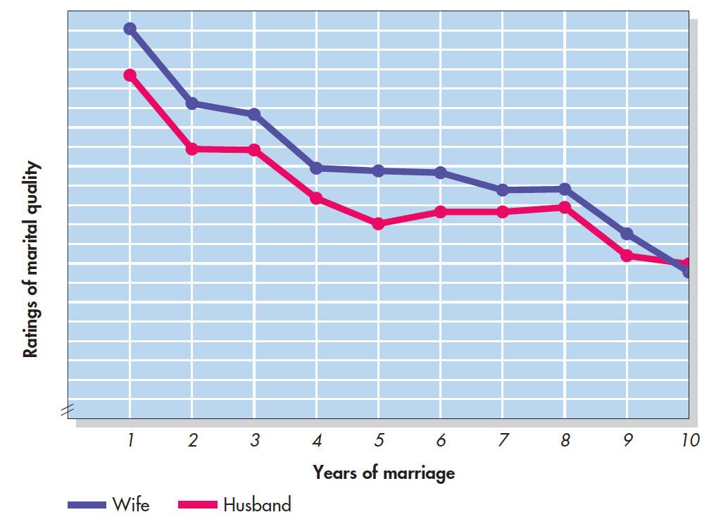
Marital Satisfaction Over Time (Kurdek, 1999)
Notes:
Figure 9.15 Marital Satisfaction Over Time In a longitudinal study that spanned 10 years, married couples rated the quality of their marriages. On average, these ratings were high, but they declined among both husbands and wives. As you can see, there were two steep drops, occurring during the first and eighth years of marriage. From Kurdek (1999).

Slide 40
Communication and Conflict
Communication patterns that often occur in troubled relationships:
  Negative affect reciprocity
  Demand/withdrawal interaction pattern
Basic approaches to reducing the negative effects of conflict:
  Increase rewarding behavior in other aspects of a relationship
  Try to understand the other’s point of view
  Identify relationship-enhancing attributions

Slide 41
Breaking Up
People’s ability to cope with divorce depends on the nature of the loss
  The extent to which the line between self and other becomes blurred
  The more interdependent couples are, the more invested they are in the relationship.
    The longer it lasts, the more devastated they will become when it ends.

Slide 42
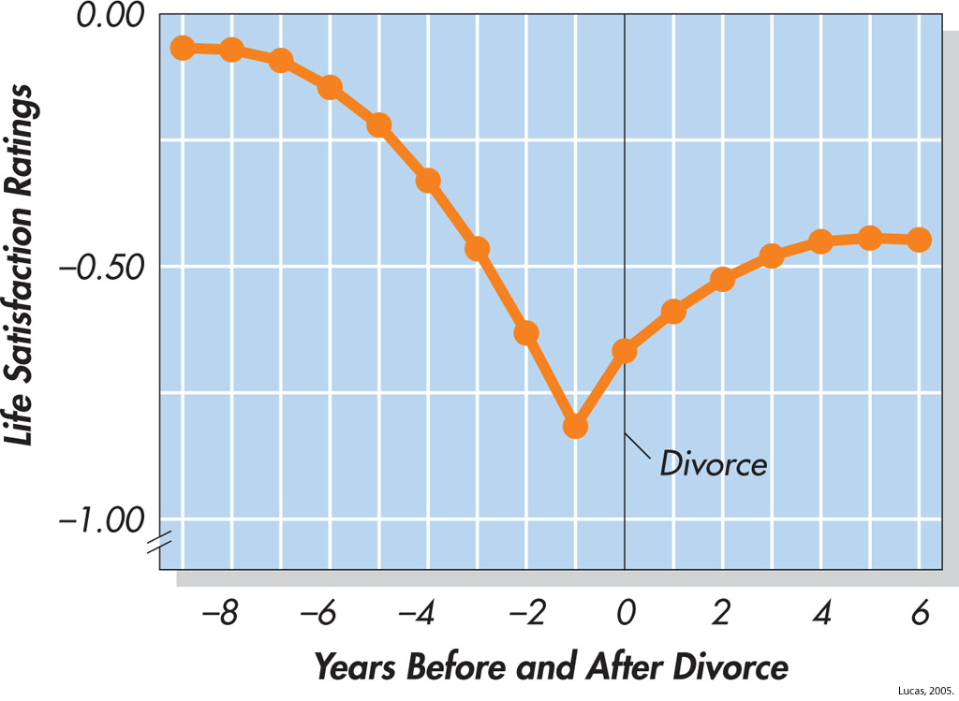
Changes in Life Satisfaction Before and After Divorce (Lucas, 2005)
Notes:
Figure 9.16 Changes in Life Satisfaction Before and After Divorce In this study, 817 men and women who were divorced at some point rated how satisfied they were with life on a scale of 0 to 10 every year for 18 years. Overall, divorcees were less satisfied than their married counterparts—a common result. On the question of whether time heals the wound, you can see that satisfaction levels dipped before divorce and rebounded afterward but did not return to original levels. It appears that people adapt but do not fully recover from this experience.
Lucas, 2005.

